Slide 1
*
* Reverse Logistics Solutions

Slide 2
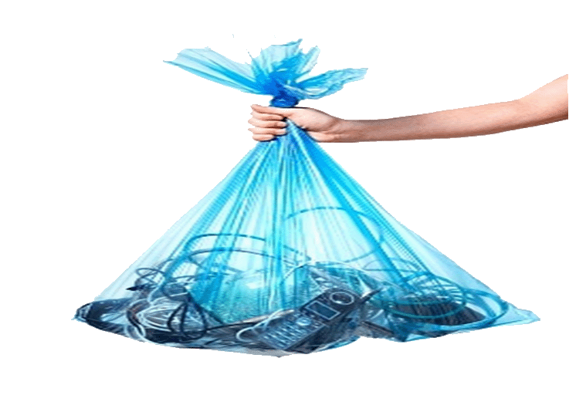
HOW YOU DISCARD YOUR E-WASTE *?
* Electronics waste (laptops, batteries, printers, chargers, ...)

Slide 3
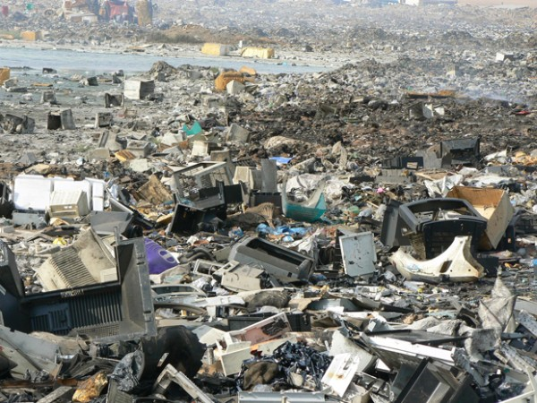
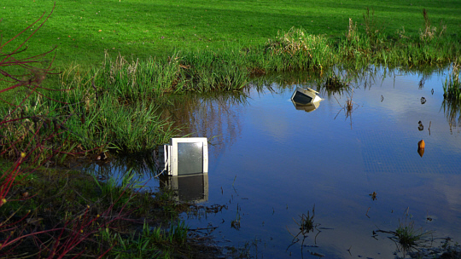
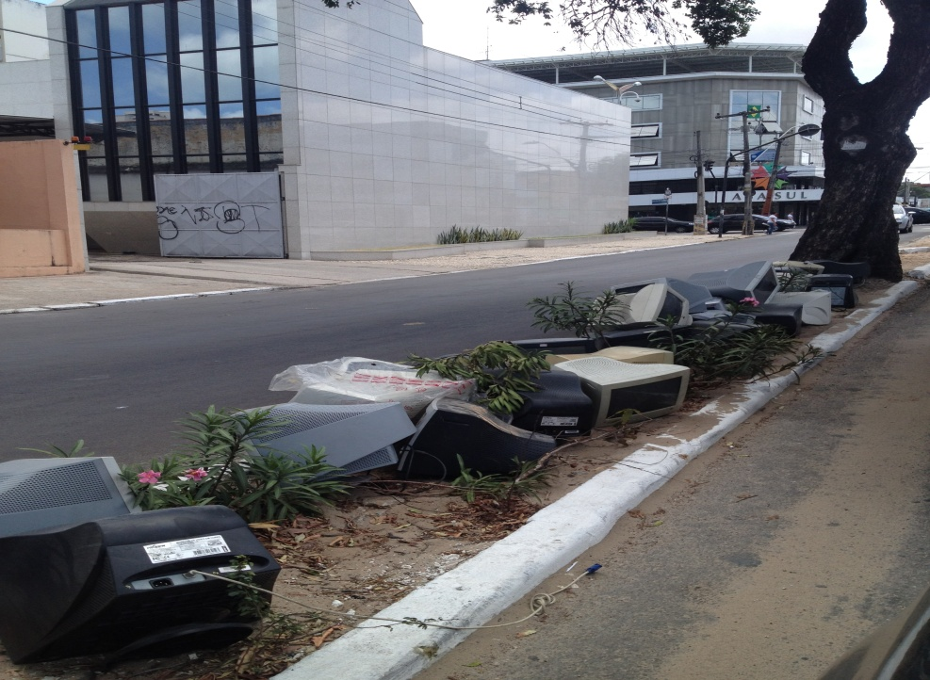
DO YOU KNOW THE DESTINATION OF YOUR E-WASTE?
07/12/2012 – 12:09

Slide 4
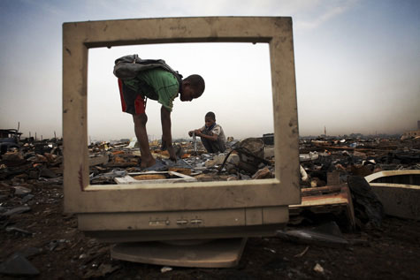
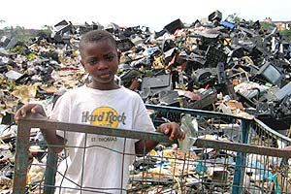
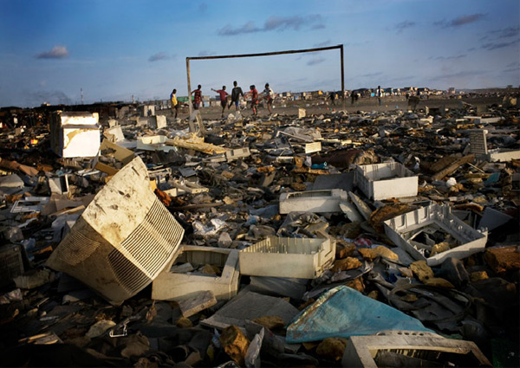
WILL YOU CONTINUE TO ACCEPT THIS REALITY?

Slide 5
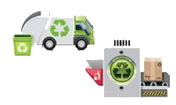
CURRENT CONTEXT
1 M tons (2013)
Difficulty in properly disposal
Pays to discard
Federal Environmental Legislation: Law 12.305/2010
Obligation to collect 17% of what is produced /sold
High cost of garbage collection (Reverse Logistics)
Location of e-waste is unknown
High Operational Costs
Lack of collection projections

Slide 6
BUSINESS MODEL (Cloud-Saas)
Facility to properly dispose
Bonus to discard
Environmental awareness
Attendance to Federal Law
Decreased cost for gathering e-waste
Information Disposal of produced/sold products
Customer Loyalty
e-waste Location
Optimizing Costs
Controlled growth of infrastructure Collection

Slide 7
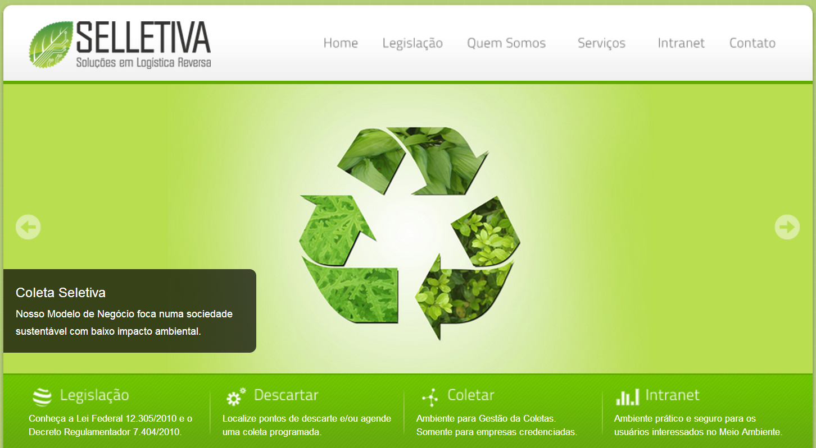
SOLUTION
www.selletiva.com.br

Slide 8
TIMELINE
05/2014
Opening Company (Recife-PE)
Production
Release Version 1.5 (Prototype)
TODAY(11/2013)
1ª Stage SINBRACS - Brasília
UKTI Finalist – Porto Digital – Recife /PE
4th Place - Eco-Smart Cities Challenge – Recife/PE
‘
1st Place – Challenge Brazil (CE/PI/MA) – Fortaleza /CE
‘
Incubation Porto Digital – Recife/PE
‘
2nd Place - Challenge GreenPeace - Porto Digital – Recife/PE
Master’s Thesis (Federal University of Ceará - UFC) – Fortaleza/PE
08/2012

Slide 9
COMPETITIVE ADVANTAGES
Low investment in fixed assets;
Potencialization of the current chain actors;
Easy replication (National / International);
Subvention Funds ($125,000.00 - 01/2014) FUNCAP – Ceará State Government.

Slide 10
OUR TEAM
Sérgio Clério Jorge Moreira
MSc in Business Administration and Controlling - UFC
Bachelor of Computing - UFC. Process Optimization and TIC
Rose Jeokellyane do Valle Moreira
MSc in Business Administration and Controlling - UFC
Bachelor in Tourism - UNIFOR. Sustainability
Luiz Alves de Lima Neto
MSc in Teleinformatics Engineering - UFC
PMP, MBA in Business Management
Daniel Freitas Colaço
MSc student in Computer Engineering - UFC
Electrical Engineer - UFC. Innovation

Slide 11
MARKET SIZE - BRAZIL
Brazil loses about U.S. $ 3,6 billion per year (IPEA – 2012).
Source: ABDI (2013)

Slide 12
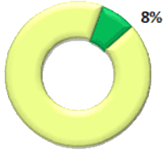
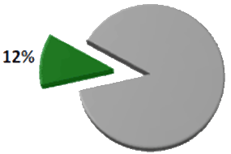
MARKET SIZE - BRAZIL
Brazilian municipalities with
separate collection in 2010
Brazilian population served by
selective collection in 2010
Source: CEMPRE (2013)

Slide 13
CONCURRENT SOLUTIONS
High cost and low profitability;
Specific and isolated.
Cases in Brazil:
e-Lixo (SP)
REVERSA SOLUÇÕES LOGÍSTICAS (SP)

Slide 14
MAIN SOURCES OF REVENUE
Short term:
Route management for companies of LR.
Medium term:
Sale of an Environmentally Correct Disposal Proof (industry, commerce, government ...);
Sale of strategic information to the industry (what/why/where/when).
Long term:
Model Replication (Franchising).

Slide 15
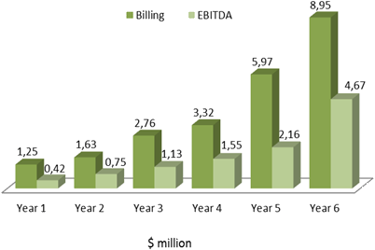
FINANCIAL PROJECTIONS
Investment Required
Year 0 – U.S. $690,000.00
Financial Projections
5%
14%
42%
IIR | Discounted Payback period | NPV
39% | 7,0 | $11,749,349,69

Slide 16
NEXT STEPS
Capture Investment
Capture Investment

Slide 17
NEXT STEPS
Capture Investment
Capture Investment
Build Partnerships
Build Partnerships
Optimize the Model

Slide 18
NEXT STEPS
Capture Investment
Capture Investment
Build Partnerships
Build Partnerships
Optimize the Model
Optimize the Model
Get Funding for R&D

Slide 19
NEXT STEPS
Capture Investment
Capture Investment
Build Partnerships
Build Partnerships
Optimize the Model
Optimize the Model
Get Funding for R&D
Get Funding for R&D
Become a Franchise

Slide 20
Thank You!
Contact: projetos@selletiva.com.br
+55 85 3088-6171 / 8706-6118

