Slide 1




Notes:
INICIALMENTE, focada em resíduo eletroeletrônico.

Slide 2
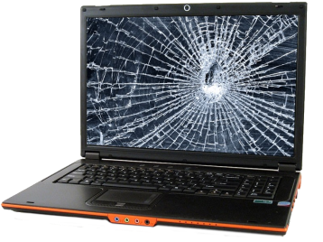
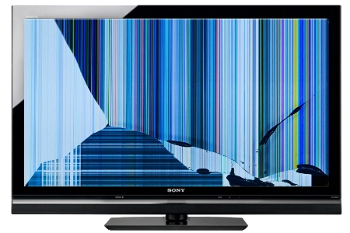
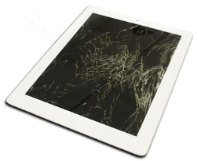
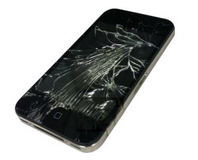
E-WASTE: what is it?
Notes:
BROKEN GADGETS
TROW AWAY

Slide 3
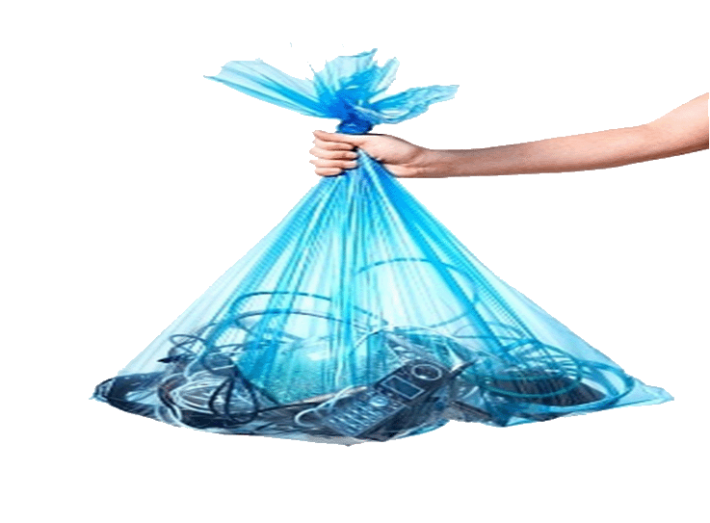
And how YOU DISCARD YOUR e-waste?
Notes:
WHAT HAVE YOU DONE WITH THAT MOBILE PHONE YOU DIDN’T WANT ANYMORE?
WHERE IS IT RIGHT KNOW?

Slide 4
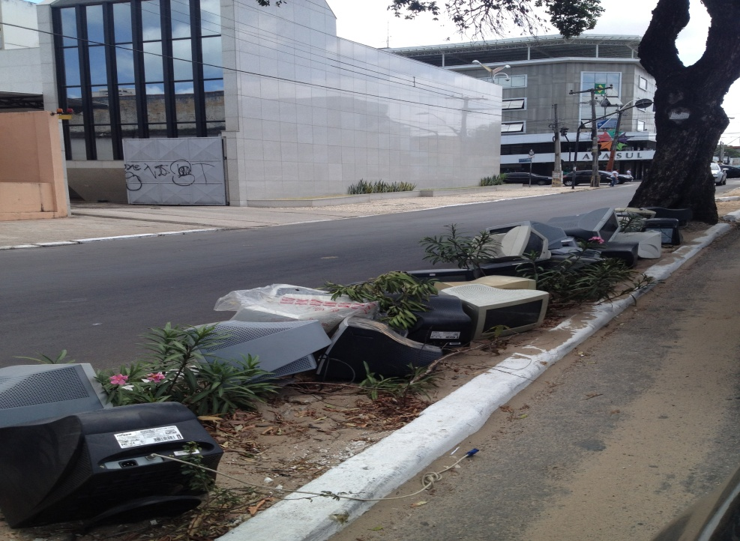
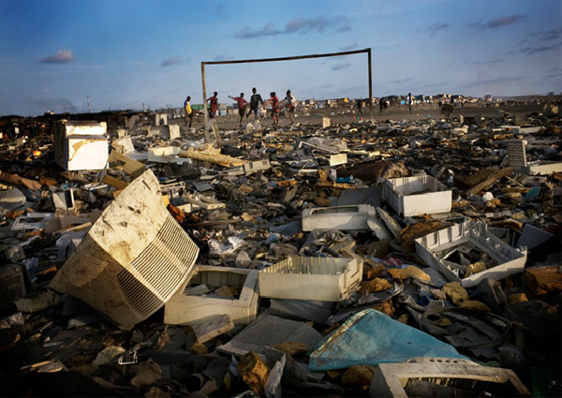
Do you know the DESTINATION OF YOUR e-waste?
Notes:
IS IT OVER HERE?
CAN YOU RECOGNIZE YOUR MOBILE PHONE OR YOUR SCREEN AT THIS PICTURE?
3 Kg / habitante Brasil (OFICIAL)
7 Kg NÃO OFICIAL

Slide 5
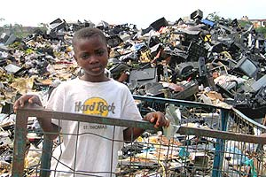
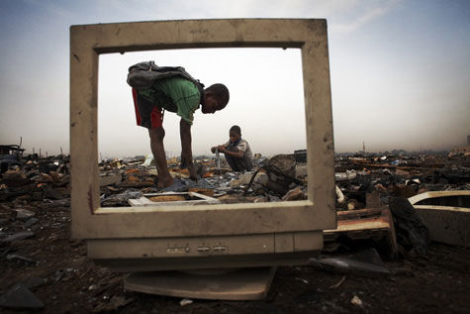
Will YOU keep ACCEPTING this reality?

Slide 6




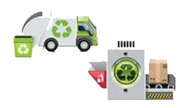
Some people, won’t!
Brazilian Environmental Legislation (Law 12.305)
Obligation to collect 17% of the previous year
production / sales (tonnes)
Financial penalties from $ 25 to $ 2.5M and
imprisonment
Notes:
NEW FEDERAL LAW
IMPOSES

Slide 7
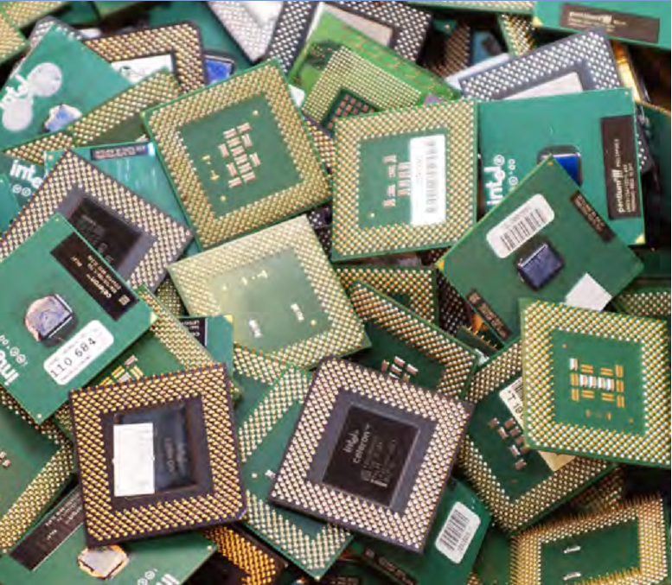
OK! Let’s help the planet! But, besides that, can I MAKE MONEY with this e–waste?
Actually, is this really “waste”?
1 tonne of e-waste contains as much gold as 5-15 tonnes of typical gold ore.
Also contains amounts of copper, aluminum and rare metals that exceed by many times the levels found in typical ores.
Printed circuit boards are “probably the richest ore stream you’re ever going to find”.
Notes:
OK, but I’m going to help to save the planet without profitability?

Slide 8
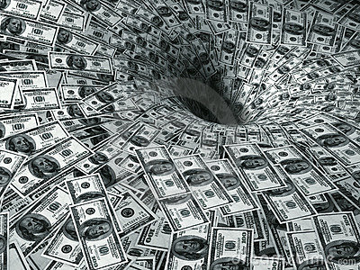
Really!? So, how much money are we talking about?
  Brazil loses about U.S. $ 3.6 billion / year (IPEA – 2012).
Notes:
VALUE DISCARDED WASTE

Slide 9


And it’s going to increase!
Thousands of tonnes
Source: ABDI (2013)

Slide 10
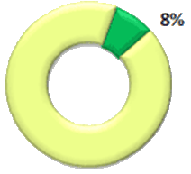
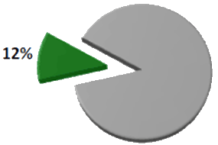
The potential market is huge!
Brazilian cities with
selective collection in 2010
Brazilian population served by
selective collection in 2010
Source: CEMPRE (2013)

Slide 11
But, if there is money, why it’s becoming trash?
Difficulty in properly disposal
- How and where to dispose? Do I have to pay?
End Users
E-waste Collection Cooperatives/Companies
Difficulty in properly collecting
Where is the waste? What its kind? How many tons?
This is not my business !!!
I have no free space at my facility! I will have extra costs!
These are toxic items!
Retails
This is not my business too!!!
I am not obligated to collect it back!
My competitor doesn’t do it. Why will I?
It is very expensive. I will loose competitive.
Manufactures
Notes:
I will loose competitive.

Slide 12




And what is the key point?
Information!

Slide 13






How does it work?
Facility to properly dispose
Bonus to discard
Environmental awareness
Attendance to Federal Law
Decreased cost for gathering e-waste
Strategic Information
  What, Who, Why, When, Where
Customer Loyalty
e-waste Location
Optimizing Costs
Controlled growth of infrastructure Collection

Slide 14
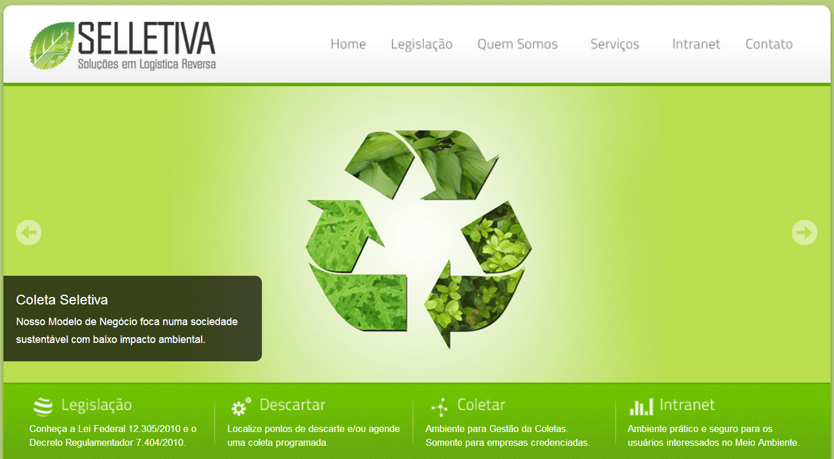
How does it work?
www.selletiva.com.br

Slide 15
Which are the competitive advantages?
  Information management;
  Low investment in fixed assets;
  Enhancement of the current chain actors;
  Easy to scale (Local / National / International);
Notes:
A chain is only as strong as its weakest link!!!
waste collectors' cooperatives

Slide 16
How do we make money with that?
Short term:
  Route management for e-waste collectors
  Medium term:
  Sale of an Environmentally Correct Disposal Proof (industry, commerce, government ...);
  Sale of strategic information to the industry (who/what/why/where/when).
  Long term:
  Franchising.

Slide 17
Hey, it seems to be a winner idea!
08/2014
1st release
TODAY(06/2014)
‘
2nd. Gov. Grant Funding
($ 125,000)
‘
1st. Gov. Grant Funding ($ 135,000)
‘
UKTI Finalist – Porto Digital – Recife /PE
‘
4th Place - Eco-Smart Cities Challenge – Recife/PE
‘
1st Place – Brazilian Innovation Challenge (CE/PI/MA) – Fortaleza /CE
‘
2nd Place – GreenPeace Challenge – Recife/PE
Master’s Thesis (Federal University of Ceará - UFC) – Fortaleza/PE
08/2012

Slide 18
Wow! Do we have competitors?
Notes:
A chain is only as strong as its weakest link!!!
waste collectors' cooperatives
High cost and low profitability;
Specific and isolated.
Cases in Brazil:
e-Lixo (SP)
REVERSA SOLUÇÕES LOGÍSTICAS (SP)

Slide 19
OK! How much money do we need?
Investment Required
Year 0 – U.S. $623,000.00
Financial Projections
IIR | Discounted Payback | NPV
43% | 6.2 | $12,791,000.00

Slide 20



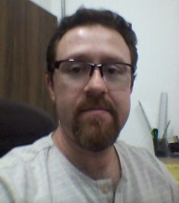
Who is in charge?
Sérgio Clério Jorge Moreira
MSc in Business Administration and Controlling - UFC
Process Optimization and TIC
Rose Jeokellyane do Valle Moreira
MSc in Business Administration and Controlling - UFC
Sustainability
Luiz Alves de Lima Neto
MSc in Teleinformatics Engineering - UFC
Business Management
Daniel Freitas Colaço
MSc student in Computer Engineering - UFC
Innovation

Slide 21



Which are the next step?
Atract Investment
Atract Investment

Slide 22
Which are the next step?
Atract Investment
Atract Investment
Build Partnerships
Build Partnerships
Optimize the Model

Slide 23
Which are the next step?
Atract Investment
Atract Investment
Build Partnerships
Build Partnerships
Optimize the Model
Optimize the Model
Get Funding for R&D ✓

Slide 24
Which are the next step?
Atract Investment
Atract Investment
Build Partnerships
Build Partnerships
Optimize the Model
Optimize the Model
Get Funding for R&D ✓
Get Funding for R&D ✓
Become a Franchise

Slide 25
I hope you have enjoyed!
Contact: projetos@selletiva.com.br
+55 85 3088-6171 / 8706-6118

